Slide 1


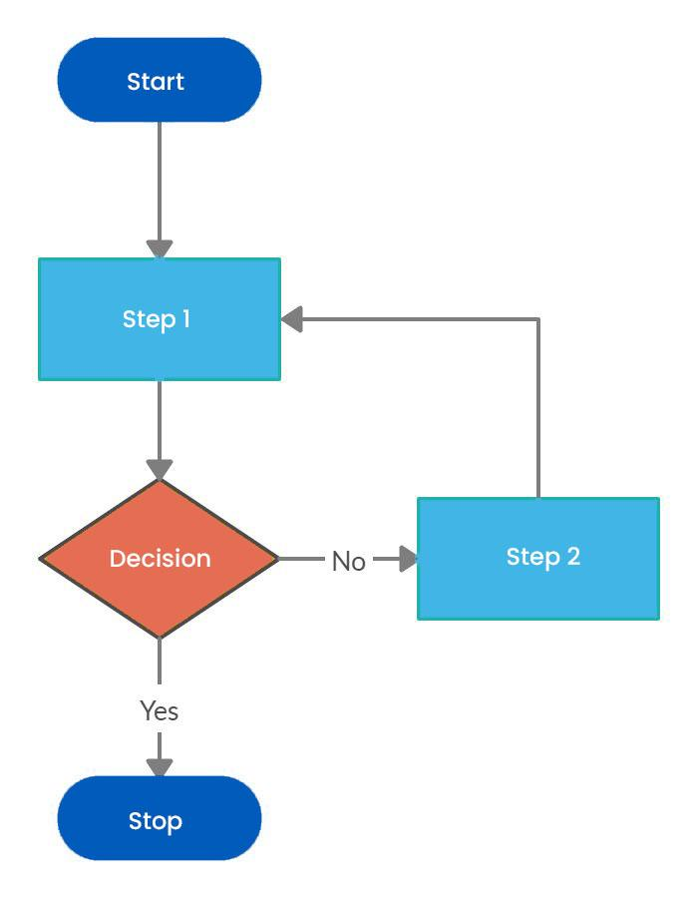
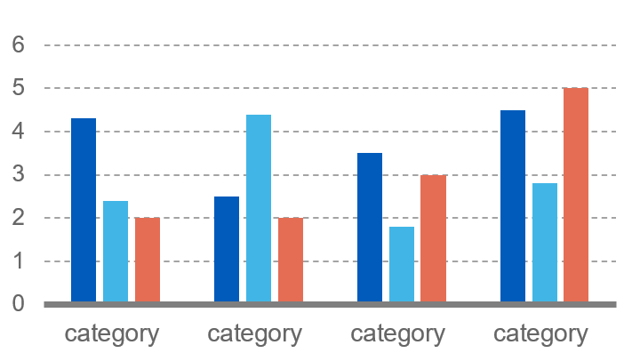

POSTER
NO.
01
DeepSentinel: A Hybrid SIEM for Insider Threat Detection
<Student Name 1>, <Student Name 2>, <Student Name 3>, <Student Name 4>, <Mentor Name>
Introduction
Conclusion
DeepSentinel is a Security Information and Event Management platform built to detect insider threats in enterprise environments. The system monitors endpoint and user activity in real time, including file access, USB events, process launches, email behavior, session activity, HTTP requests, and sensitive resource usage. Unlike traditional log collectors, DeepSentinel combines behavioral analytics with machine learning to identify subtle misuse patterns that may not match fixed signatures. The platform also adds incident grouping, audit trails, role-based access control, and real-time notifications for SOC operations and compliance workflows.
DeepSentinel demonstrates that insider threat monitoring is stronger when behavioral analytics, anomaly detection, and response workflows operate as one system. The framework delivers continuous event collection, interpretable risk scoring, incident grouping, and security automation in an enterprise-ready SIEM. Current results show useful accuracy and low latency for real-time monitoring. Future work can focus on larger-scale evaluation, adaptive threshold learning, richer NLP-based threat analysis, and wider deployment across multi-LAN enterprise environments.
Results & Discussions
Project validation shows about 80% detection accuracy with near real-time performance. Average event latency is approximately 100-150 ms, and the server handles close to 1,000 events per minute in a single-node setup. The hybrid scoring approach improves analyst trust because alerts contain both a score and an explanation. The architecture is operationally useful because incidents, user risk trends, and audit evidence are retained for investigation and compliance reporting.
References
Problem Statement
[1] DeepSentinel Project Documentation, "DeepContext.md," ver. 4.0, Apr. 1, 2026.
[2] F. T. Liu, K. M. Ting, and Z.-H. Zhou, "Isolation Forest," in Proc. IEEE ICDM, 2008, pp. 413-422.
[3] M. Sakurada and T. Yairi, "Anomaly Detection Using Autoencoders with Nonlinear Dimensionality Reduction," in Proc. MLSDA, 2014, pp. 4-11.
[4] A. Paszke et al., "PyTorch: An Imperative Style, High-Performance Deep Learning Library," NeurIPS, 2019.
Insider threats are difficult to detect because valid users can misuse approved access without triggering perimeter defenses. The objective of this work is to build a practical SIEM that correlates endpoint activity, assigns interpretable risk scores, and supports rapid response for insider threat scenarios.
KEY METRICS
Accuracy ~80% | Latency 100-150 ms | Throughput 1,000/min
11 Features | 3 ML Models | 9+ Event Types
Hybrid Scoring | JSONL Storage | Multi-LAN Ready
Methodology
DeepSentinel uses a hybrid detection pipeline. Windows agents collect events and send them to a Flask server through the /receive_log API. Events are normalized into 11 behavioral features and scored using MinMax scaling, Isolation Forest pre-screening, and a PyTorch autoencoder. A heuristic layer evaluates after-hours access, threshold violations, sensitive path activity, and suspicious processes. These signals are blended into a final risk score with an explanation. Supporting modules provide UEBA, peer analysis, incident management, audit logging, honeypots, screen recording, and notification workflows.
Key performance and design metrics from the deployed hybrid detection pipeline are summarized in the table.

